Slide 1
BANK MANAGEMENT SYSTEM
Submitted by :
Name : Ashwini B
Batch No : 6258
Branch : Bangalore

Slide 2
INTRODUCTION :
In this java program, we will learn how to create a small project like banking system? In this program, we are using some of the banking related options like deposit, withdrawal etc.

Slide 3
This java program has following main menus:
Display All
Search By Account
Deposit
Withdrawal
Exit
Initially, we will add some (N) customers to the bank and then we can display all account details using menu 1), menu 2) is used to search the bank account, menu 3) is used to deposit money in particular account, menu 4) is used to manager withdrawal and menu 5) is used to exit from the program.

Slide 4
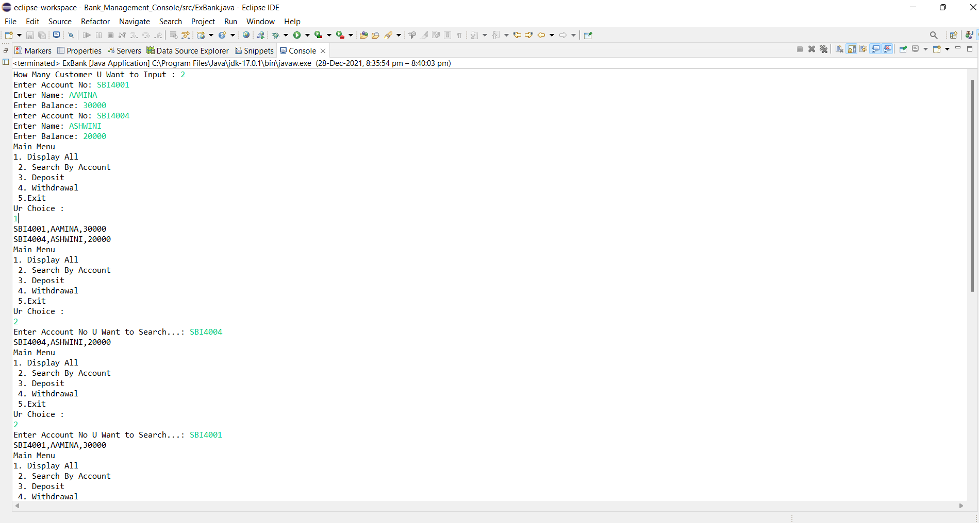
Output:

Slide 5
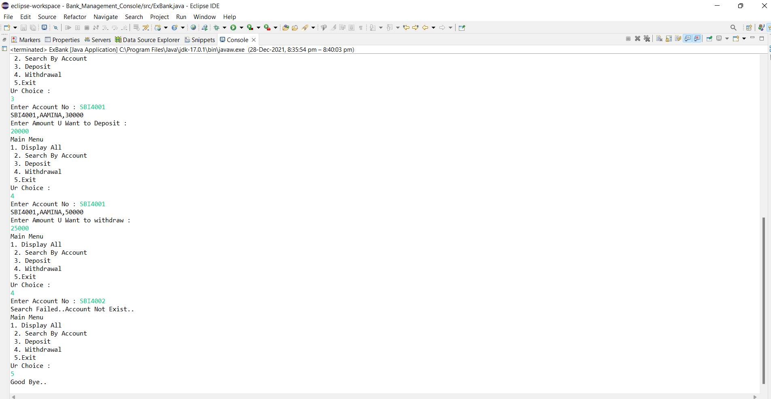

Slide 6
THANK YOU

